Slide 1


Federal Prospects Hockey League Expansion
Jackson, MI or Racine, WI
Prepared by Tony Kibling
April 18, 2021

Slide 2
Table of Contents
Executive Summary
Methodology
Michigan = Hockey
Lay of the Land
Where is Jackson?
Demographics: Jackson, MI (area)
Location, Location, Location
No team for Racine
Action Steps
Conclusion
References

Slide 3
Executive Summary
FPHL Recommendation: Jackson, MI
Background
The Federal Prospects Hockey League (FPHL) is looking to expand its Western Division. They have narrowed down their potential locations to two cities: Jackson, MI and Racine, WI. The league would prefer to expand into thriving, smaller cities that do not have any other professional sports presence.
The FPHL would also like a community with a stable or growing population and income. There should be some local dining establishments as well. Our goal is to research both cities based on the criteria requested by the league and recommend the best place for expansion.
Recommended Action
When comparing the two cities, Jackson, MI provides a better opportunity for expansion. First, Jackson is located along I-94 roughly 80 miles west of Detroit, home of the NHL’s Red Wings, and is equidistant to two BIG10 college programs at Michigan and Michigan State.
Although the population in the area has slowly decreased over the past 20 years, the average household income has increased by 21.2% and expected to grow another 17.4% by 2025. They spent roughly 6% of their income eating out and about 40% of that spending is on dinner.
On the Northwest side of Jackson, there is an existing arena (Optimist Ice Arena) being used for recreation hockey leagues.
This facility will need some upgrades but it can likely be used. The arena is near I-94, shopping (including retail sporting goods stores), hotels and restaurants.
Lastly, the state of Michigan has more hockey players per million than Wisconsin. There should be ample opportunities for players and development.
Rejected Option
Racine, WI has some good qualities as well. Although, the population has also been slowly decreasing since 2000, the median household income has increased at a higher rate. Even though they have a higher income, the average amount spent eating out is almost the same as Jackson. Racine is
located roughy 6 miles east of I-94 between Milwaukee and Chicago. There are some restaurants near downtown. The key difference is that Racine does not have an existing arena and recent plans to build one were put to rest in 2017.
Action Steps
1. Reach out to Optimist Ice Arena board for leasing opportunities.
2.Discuss enhancements to seating and concessions for the arena.
3.Start to fundraise and look for corporate sponsors.
4.Establish retail presence for fan merchandise (future).
Currently, the FPHL has a presence in the state of Michigan with two teams (Port Huron and Battle Creek).
Bleacher Report ranks Michigan as the #2 hockey state.
Jackson, MI is in Jackson County, and serves as the county seat.

Slide 4
Methodology
League information
To become more familiar with the league, the first step I took was to review the Federal Prospects Hockey League website (https://www.federalhockey.com/home).
The website shows current teams (two in Michigan) and former teams. Choosing an already defunct market from the FPHL would not be beneficial for this study.
I also looked for any existing expansion plans and ruled those areas out.
Then, I compared metrics of the cities in the league to cities in Michigan to find an ideal location.
Demographic Data
Markets growing both in population and income would be appealing to the league. The following resources were used to understand and gather that data.
2019 American Community Survey via https://censusreporter.org/
2000 actuals, 2020 estimated, and 2025 projected data from Gale Business: DemographicsNow
Consumer Data
The league is also looking for communities with consumers that spend money eating out. Hence, the following report was used.
Consumer Expenditure Food Beverage Grocery Detail from Gale Business: DemographicsNow
Searching Yelp was also used to determine which cities have ample dining out options for consumers.
Other Research
Additional information was pulled from the following sources.
Wikipedia to research the cities and their areas for interesting information.
The Journal Times in Racine for previous stories about their sports teams.
Numerous websites that contain data about where hockey players are from to compare Michigan vs. Wisconsin.
Maps from Google, Bing, Michigan.gov and Yelp to better understand each city’s layout.

Slide 5
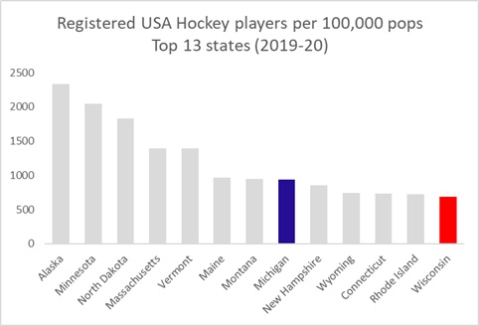
Michigan = Hockey
Hockey is popular in the state of Michigan.
The Bleacher Report ranked Michigan as the #2 hockey state in the United States behind only Minnesota. Along with the great traditions at Michigan State and the University of Michigan, the Detroit Red Wings are quite possibly the most popular hockey team in America. (Johnson, 2011) Wisconsin came in at #6.
The National Hockey League (NHL) brings in players from all over the world. While Canada has by far the most players in the league, the United States has a fair share. Within the U.S., players born in the state of Michigan come in second in the league with 39. Fun fact, current NHL player, Steven Kampfer from the 2011 Stanley Cup champion Boston Bruins, was born in Ann Arbor and grew up in Jackson, MI. (Wikipedia, 2021) Although Wisconsin is respectable in seventh, Michigan has three times as many players. (QuantHockey, 2021) From an all-time NHL perspective, the state of Michigan has the third most players with 180. This is more than four and a half times as many as Wisconsin. (Hockey Reference, 2021)
Aside from the major college programs at the University of Michigan and Michigan State University, and the NHL’s Detroit Red Wings, the FPHL’s Western Division has two teams currently operating in the state of Michigan – Battle Creek and Port Huron.
The nationally recognized USA Hockey organization is divided into 12 districts and multiple age groups. Of the 12 districts, there are only four states with their own district, and Michigan is one of them. According to the total registered member counts, the Michigan district accounts for approximately 47,000 players or 8.3%. Wisconsin, on the other hand, has 20,000 members and is grouped with five other states in the Central district. (USA Hockey, 2020)
Data sources: USA Hockey and United States Census Bureau
Adapted by Tony Kibling

Slide 6
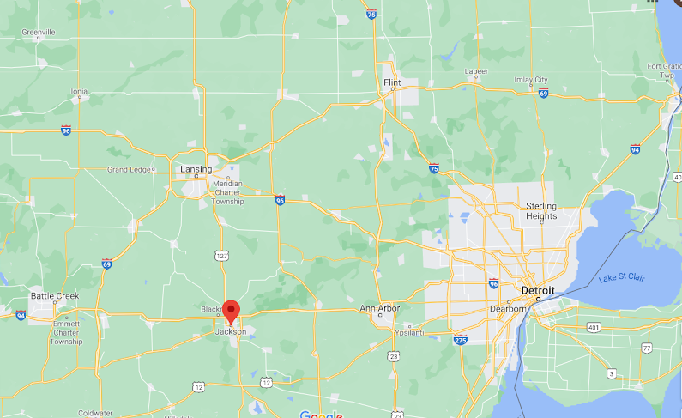
Lay of the Land
FPHL-
Port Huron Prowlers
B10 - MSU Spartans
FPHL-
Battle Creek Rumble Bees
NHL - Detroit Red Wings
B10 - UM Wolverines
Jackson, MI
Image source: google.com/maps
Adapted by Tony Kibling

Slide 7
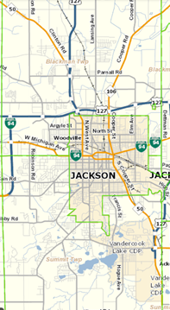
Where is Jackson?
Blackman Twp
Let’s go to the maps
In southern Michigan, the city of Jackson can be found in central Jackson County and serves as its county seat. The city is located at the junction of four major highways: I-94, US 127, M50 and M60. Jackson is almost equal distance to Ann Arbor to the East, Battle Creek to the West and Lansing to the North. Detroit is roughly 80 miles to the East.
The city of Jackson has a vibrant downtown with parks, coffee shops, restaurants and other businesses. Most of the residential neighborhoods surround the downtown area. While continuing with the research, many more residential and commercial areas were found to the west and northwest. These areas include shopping centers, restaurants and more.
After looking at the maps more closely, the neighborhoods and businesses continue into the adjacent townships of Blackman and Summit. This includes the Jackson County Airport which is located in Blackman Township.
Therefore, when considering Jackson, MI, we have to include these two neighboring townships with our data and analysis since they contribute to the area.
Summit Twp
Image source: Michigan.maps.arcgis.com
Adapted by Tony Kibling

Slide 8
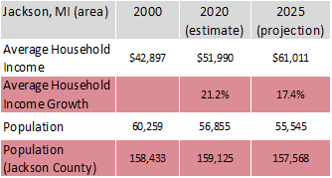
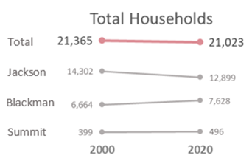
Demographics: Jackson, MI (area)
Household Income
As previously discussed, the townships of Blackman and Summit that border Jackson, MI, must be included in our analysis and data since they contribute to the overall geographical area.
The FPHL prefers a market that has income growth. This area meets those requirements. Since 2000, the average household income has increased by more than 21% and a projection to 2025 by the Gale Business DemographicsNow predicts continued income growth in the area.
Data source: Gale Business Demographics April 15, 2021
Adapted by Tony Kibling
Steady Population and Households
A new team should also be, ideally, in a market with a growing population. Although the total population for Jackson, Blackman and Summit has decreased over the last 20 years, the total number of households for all three cities combined remains steady.
When looking at all of Jackson County as a comparison, the population remains relatively flat. This suggests that people are moving out of the cities but still staying in the area by moving to a surrounding community.

Slide 9
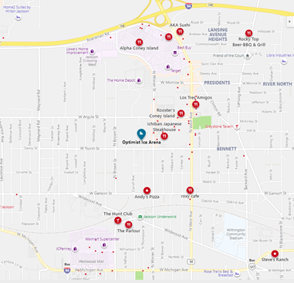
Location, Location, Location
Existing facilities
One of many advantages with the Jackson area is the existing hockey arena called Optimist Ice Arena. The arena currently hosts adult and youth hockey leagues. The banquet hall and facility can be rented for events as well. In addition, Optimist Ice Arena was the home to the minor pro hockey team, the Jackson All-Americans, that played 1986-1989. Since a team has not played here for over 30 years, upgrades to the arena are likely.
There are 12 hotels within 2.5 miles of the arena. There should be no issues for teams traveling to play in Jackson and for incoming fans that want to stay.
Concessions at the arena will be a necessity. However, if the attendees want to grab a bite before, or after, the game, there are more than a dozen restaurants of varying cuisine plus fast food chains and pizzerias in the vicinity. According to Gale Business DemographicsNow reports, the residents utilize 40% of the money they allocate for eating out at dinner, having many nearby options is a plus.
In addition, there are two shopping centers within one mile of the arena, Westwood Mall to the South and Jackson Crossing to the North. Both shopping centers boast a variety of places including sporting goods stores, Champs Sports and Dunham’s Sports respectively.
Restaurants and shopping near Optimist Ice Arena
Image source: bing.com/maps

Slide 10
No team for Racine
Demographic and Consumer Data
Racine’s population is greater than the Jackson, MI area, albeit slowly declining at a similar rate. The number of households is also constant and income growth is trending upward. Both could be acceptable for the league’s requirements.
Consumer Data
The residents of Racine have similar spending habits as well. They eat out at almost the same clip and spend the same percentage at dinner so this is not a differentiating factor to consider.
Geography
Overall, there are fewer hotels in Racine and most of them are in a cluster approximately five miles west of downtown. Some shopping centers are on the west side of Racine. Both Champs Sports and Dunham’s Sports have locations here.
Racine has many restaurant varieties including fast food and pizzerias. Being on Lake Michigan enables waterfront activities.
The nearest hockey arena is 15 miles away to the south in Kenosha, WI. Although hockey is popular in Wisconsin, it’s not as popular as Michigan.
No arena, no team
Ultimately, the decision was made to deny Racine a team in the FPHL because they do not have an arena to play at.
“You may recall that in 2016, Racine was in the running to become a minor-league home of the Milwaukee Bucks. A Bucks affiliate was to be placed somewhere in Wisconsin, and there was a talk of building a Downtown arena to have that team awarded to Racine.
Racine and other Badger State cities lost out to Oshkosh, which became the home of the new Wisconsin Herd of the NBA Gatorade League, formerly known as the NBA Development League. In Racine, the arena plan fizzled out and was finally squelched in one of Cory Mason’s first acts as mayor.
Thanks for that, Mr. Mayor. We liked that decision in late 2017, and we like it even more today...The return on investment for a Racine minor-league team’s arena was iffy at best.” (JTED, 2019)

Slide 11
Action Steps
1. Reach out to Optimist Ice Arena board for leasing opportunities.
The Optimist Ice Arena is governed by a Board of Directors made up of seven members of the Optimist Club of Jackson. Put together a pitch requesting the use of the facility for a minor league hockey team. Advise them that the intention is to increase the quality but not change the quantity of adult/youth leagues. Advanced scheduling will be key.
2.Discuss enhancements to seating and concessions for the arena.
Current seating capacity at Optimist Ice Arena is limited to some bleachers on one side of the ice and standing room. There is also a snack bar. Most arenas in the league have a seating capacity >3,000. However, a couple are smaller including the Watertown Wolves (Syracuse). They play in a 1,500 seat area.
3.Start to fundraise and look for corporate sponsors.
Contact local businesses for sponsorship opportunities such as CMS Energy which has their headquarters in downtown Jackson. This can consist of sponsoring a seating section, advertising on merchandise for game day giveaways (bobbleheads, keychains, etc.), and doing events (teddy bear toss or chuck a puck).
4.Establish retail presence for fan merchandise (future).
A fan shop at the arena is a priority, as is reaching out to the larger sporting goods locations nearby and local retailers.

Slide 12
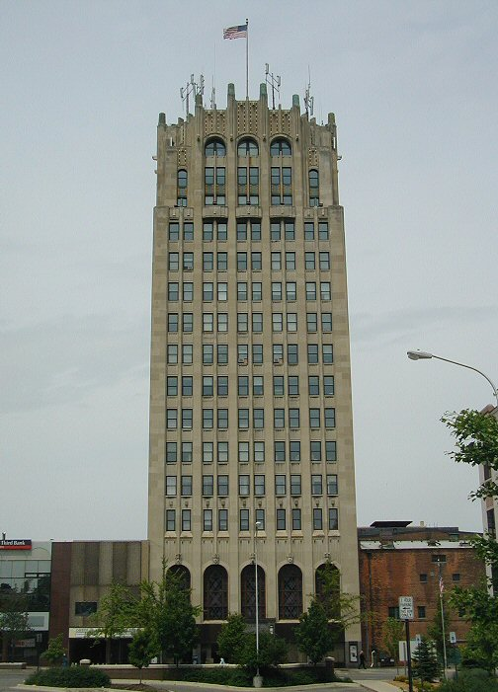
Conclusion
FPHL Recommendation: Jackson, MI
The Federal Prospects Hockey League (FPHL) is committed to providing quality family entertainment at affordable prices in some of the most exciting new and established hockey markets in North America. (FPHL, 2021)
As the report illustrates, Racine and Jackson have similar metrics. Both have a variety of restaurants, retail and hotels. Neither Jackson nor Racine have a growing population; however, household numbers remain steady, income is growing and consumers are spending. In the end, there is an existing facility in Jackson that previously hosted a minor league hockey team which gives it a leg up on Racine.
The state of Michigan is a proven home for hockey and Jackson will be a great home for the next FPHL team.
Jackson County Tower, Jackson’s tallest building
By Original uploader was Criticalthinker at en.wikipedia - Transferred from en.wikipedia to Commons., CC BY-SA 3.0, https://commons.wikimedia.org/w/index.php?curid=3392227

Slide 13
References
FPHL. 2021. https://www.federalhockey.com/home
“Jackson, MI”, Wikipedia. https://en.wikipedia.org/wiki/Jackson,_Michigan
“Racine, WI”, Wikipedia. https://en.wikipedia.org/wiki/Jackson,_Michigan
Optimist Ice Arena. 2021. https://www.optimisticearena.com
Jackson Area Hockey Association. 2021. https://www.jahahockey.com/rinks
Jackson All-Americans. 2021. https://icehockey.fandom.com/wiki/Jackson_All-Americans
Johnson, Erik. “The State of Hockey: Ranking the Top 10 Hockey States in America”. March 23, 2011. https://bleacherreport.com/articles/643555-the-state-of-hockey-ranking-the-top-10-hockey-states-in-america
U.S. Census Bureau. 2019. American Community Survey 5-year estimates. Retrieved from Census Reporter Profile page for Jackson, MI http://censusreporter.org/profiles/16000US2641420-jackson-mi/
U.S. Census Bureau. 2019. American Community Survey 5-year estimates. Retrieved from Census Reporter Profile page for Racine, WI http://censusreporter.org/profiles/16000US5566000-racine-wi/
“Jackson, MI”. 2021. Gale Business DemographicsNow. https://dnow-gale-com.proxy.lib.umich.edu/dnow/?p=DNOW&u=lom_umichanna#data-reports
“Racine, WI”. 2021. Gale Business DemographicsNow. https://dnow-gale-com.proxy.lib.umich.edu/dnow/?p=DNOW&u=lom_umichanna#data-reports
“Summit, MI”. 2021. Gale Business DemographicsNow. https://dnow-gale-com.proxy.lib.umich.edu/dnow/?p=DNOW&u=lom_umichanna#data-reports
“Blackman, MI”. 2021. Gale Business DemographicsNow. https://dnow-gale-com.proxy.lib.umich.edu/dnow/?p=DNOW&u=lom_umichanna#data-reports
“Jackson, MI”. 2021. Yelp. https://www.yelp.com/search?find_desc=restaurants&find_loc=Jackson%2C%20MI&sortby=rating
“Racine, WI”. 2021. Yelp. https://www.yelp.com/search?find_desc=restaurants&find_loc=Racine%2C%20WI
QuantHockey. “Active NHL Players by Birth State”. 2021. https://www.quanthockey.com/nhl/state-totals/active-nhl-players-career-stats.html
Hockey-Reference. “All-time NHL Players by Birth State”. 2021. https://www.hockey-reference.com/friv/birthplaces.cgi
USA Hockey. “Membership Statistics”. 2020. https://www.usahockey.com/membershipstats
Lay of the Land, slide 6. 2021. www.google.com/maps
Michigan Municipalities and Unincorporated Places, slide 7. 2021. https://michigan.maps.arcgis.com/apps/webappviewer/index.html?id=f0ead3f8bc61428fbe7339eb2c51f412
Restaurants, slide 9. “Jackson, MI”. 2021. https://www.bing.com/maps?FORM=LGCYVD
Jackson County Tower, slide 12. 2021. https://commons.wikimedia.org/w/index.php?curid=3392227
US State Population. 2021. https://www.census.gov/en.html
JTED. August 17, 2019. The Journal Times Editorial Board. https://journaltimes.com/opinion/editorial/editorial-racine-turns-out-a-lucky-loser-in-race-to-land-bucks-affiliate-and-arena/article_54afe23b-79f2-551b-a887-f111435d8d8d.html

